Slide 1
Opportunities from Disaster:
The Case for Using the Circular Economy in Debris Management
Survey Insights
An Update to the National Demolition Association (NDA) Industry Committee
By: Toy Andrews
Co-Advisors: Prof. Randy Rapp & Prof. Emad Elwakil
Committee: Prof. Eric Dietz & Prof. Sam Baroudi
School of Construction Management Technology
April 16, 2021
Notes:
Request to record for personal and professional records and my absent co-advisor, Dr. Emad Elwakil and for the rest of my committee not on the call today.
Intro
Professor of Restoration and Reconstruction, Primary Academic Advisor

Slide 2
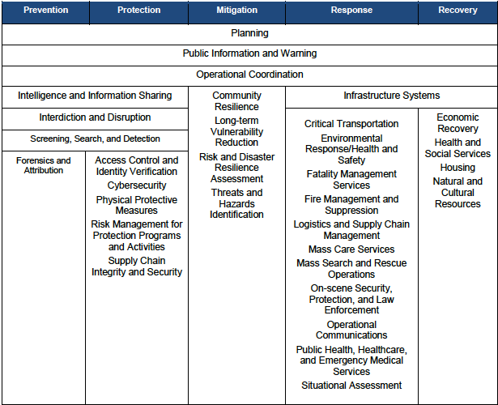
Study Framework
Interviews with county planners
Interviews with successful business models
Two rounds of survey for contractors
Survey results to practioners
Proposed new business models and planning policies
Source: https://www.fema.gov/national-preparedness-goal
Opportunities
Notes:
When looking at the National Preparedness Goals set out by the US Government through the lens of the disaster operations cycle, opportunities exist throughout the framework for businesses and local governments/municipalities to seize the initiative and capitalize on the ways to get more out of the resources they currently have and can retrieve.
My research has been primarily concerned with the Response and Recovery parts of the national preparedness goals framework, as seen in the figure. As with most complex operations, there is no single source influence when it comes to response and recovery. Some of the forms to success throughout the disaster operations cycle are cast in the Prevention, Protection, and Mitigation phases too.
(After reading, CLICK mouse) The framed areas on the screen indicate where and how parts of this research highlights these preparedness goals within this continuum of disaster operations. These opportunities bubble up for businesses that deal in C&D debris operations, but also as part of a whole-of-community aspect in preparations, response, and a more sustainable model of operations.

Slide 3
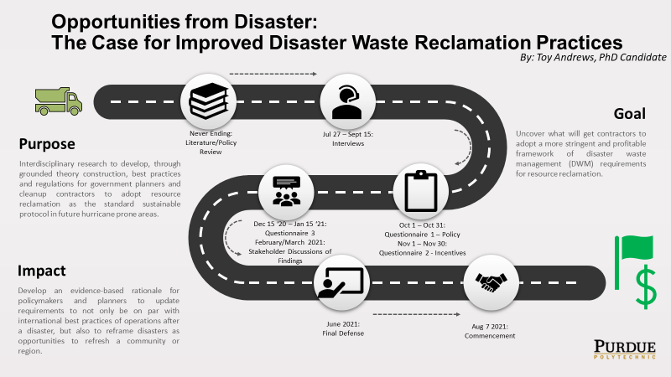


Opportunities from Disaster:
The Case for Using the Circular Economy in Debris Management
July 2021: Final Defense
Notes:
There is growing research of how the circular economy (CE) is gaining traction in applications for resource supply professionals everywhere in multiple sectors of the economy, so application in the DWM arena is a logical step in the right direction.
The PURPOSE of this study is to uncover the barriers to and profitability from implementing a sustainable disaster waste management enterprise.
The study's focus is on the subset of debris cleanup contractors (or potential ones) and analyzing their responses to both current situations and hypothetical methods to make more business opportunities, profits, and environmental sustainability.
Through NDA's access to the demolition field, the study can directly influence the business plans of the companies within the association. The results are summarized in the following slides using the (Strengths, Weaknesses, Opportunities, and Threats (SWOT) strategic analysis model. My intention is to share with the respondents and greater Association membership, these insights into the hesitancy, eagerness, and overall feelings of the growing industry trend presented in the surveys. Over the course of the study, many factors and best practices were gathered and will be included in the final report this summer.
Toy’s research is looking at the following two questions:
1. What incentives are going to drive cleanup contractors to adopt sustainable resource reclamation practices?
2. Second, if presented with options the Association can champion, what is necessary to facilitate a speedier and more sustainable protocol?
NDA’s role:
Survey Facilitation: Through the network of demolition experts in the construction industry, surveys to those most sought out by state, county, and local governments for contract work for clean-up, the study can gain the critical insights to their motivations for business success, policies that are counter to making those profits, and appetite for making suggested changes in the business models.
Survey Support: People tend to only do surveys if there’s an incentive. NDA’s funds would allow for a small (~$20 each) reward for completing the survey. Total was under $700.
Results Championing: The outputs of this study are intended to find further business opportunities for those within the NDA and can lead to a branching out opportunity for all of the representative businesses for hazard pre-identification and rapid response.

Slide 4
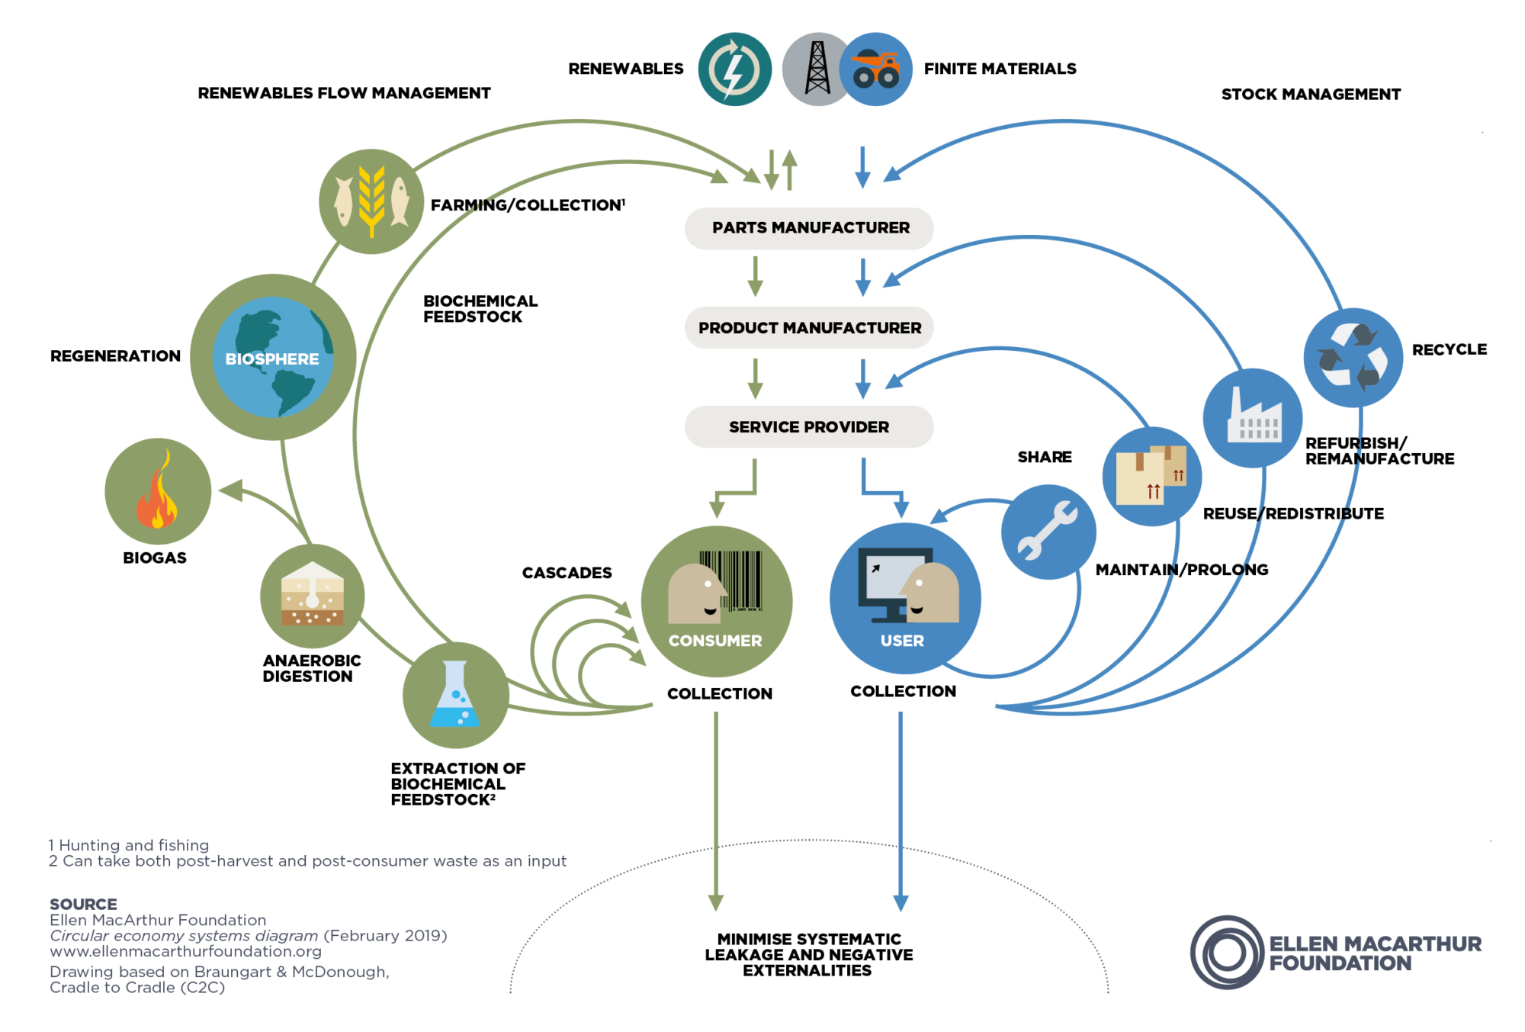
Butterfly Model
Notes:
Committee, you’ve either been exposed to this or have been part of this cycle throughout your career in the C&D industry.
The cycle’s right wing of the ‘butterfly’ show what industrial ecologist and authors of Cradle-to-Cradle call, “Industrial Nutrients”. The Ellen MacArthur Foundation out of the UK further codified this notion into the Butterfly model you see before you.
Starting at the top, that’s where items come into the system. That’s the finite items of trees, cement, metal ores, etc.. The following steps in that column are where those raw materials are turned into items useful to builders and product manufacturers such as, following the same theme, lumber, concrete, and steel beams, etc. From there, the product that then goes into full assembly, the trusses, foundations, and steel—framed commercial walls, and then construction can begin with the USER…the builders.
As a demolition business, you perform the function as, what the model shows in the top right, of Stock Management.
Within the 4 loops back to the materials flow backbone, you’re already familiar with the sharing concept when it comes to your leased heavy-machinery and how you may sub-contract out a function to another company for efficiency.
In the next outer loop, your businesses are already familiar with the maintenance and prolonging of either equipment or as part of a renovation to a building to get more service life out of it.
The next two loops are the most related to you in the Demolition and debris management fields. Redistribution and Recycling are how everything stays out of the landfills and back into the materials stream.

Slide 5
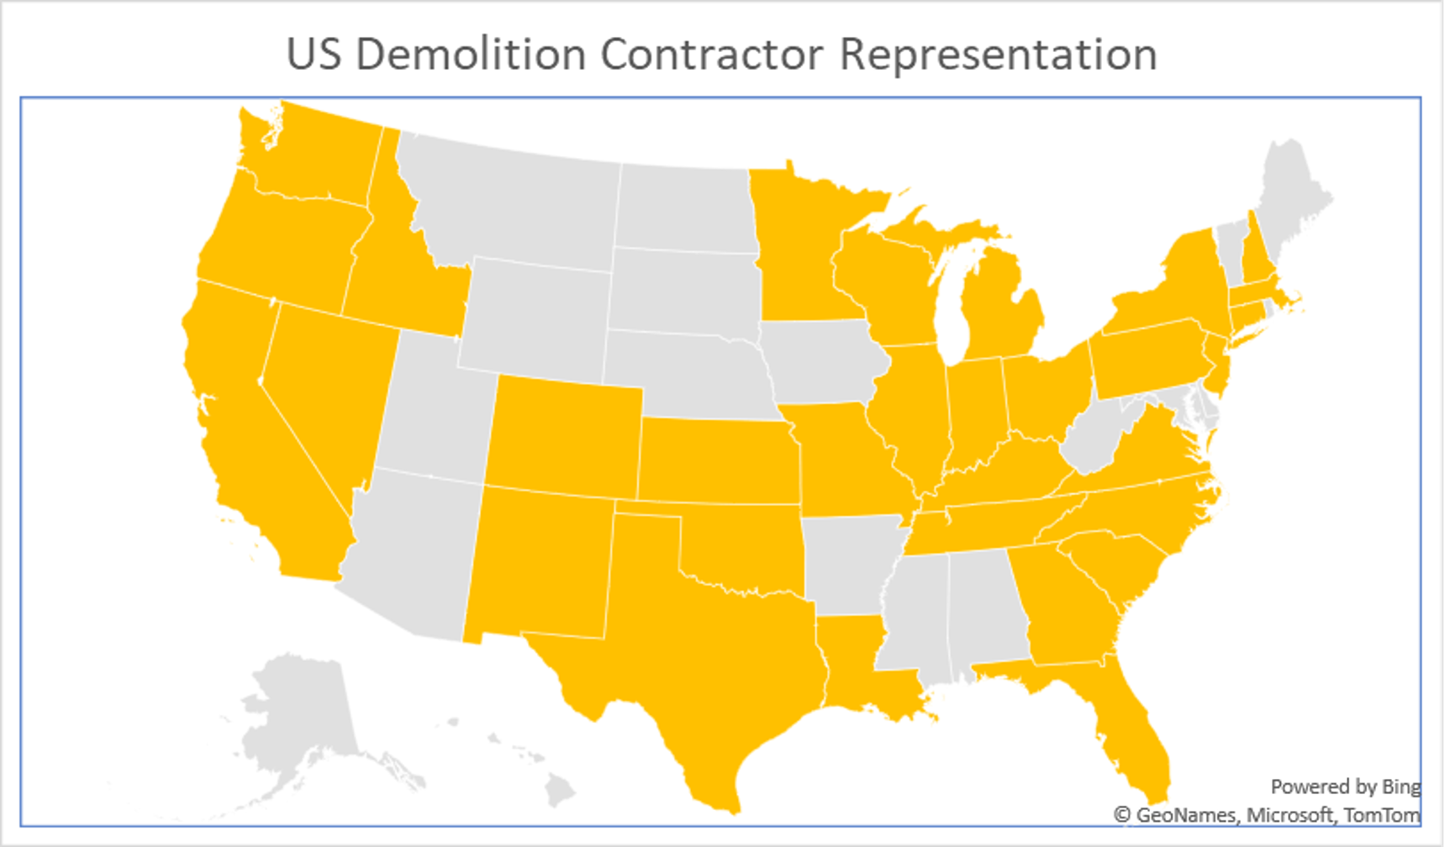
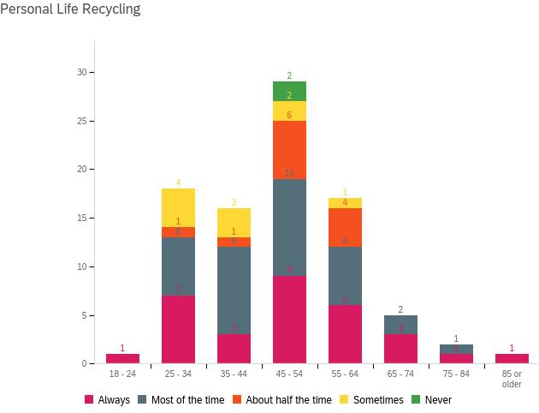
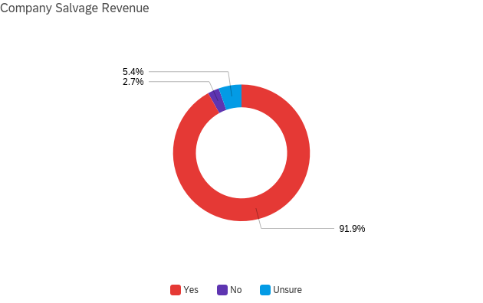
SWOT - Strengths
trengths
89 Overall Participants
Across multiple levels of Small-to-Medium Enterprises with most, 31 of 50 states, represented in the respondents. 52 for Survey 1, 37 for Survey 2.
Optimism for the Future
86.5% of respondents recycle in their personal lives.
Familiar with the Concept in Practice
Scrapping for additional income is already on the minds and part of the operational concept for demolition materials recovery.
Notes:
© Copyright PresentationGO.com – The free PowerPoint and Google Slides template library
Survey 1 was preliminary and common to both surveys. Survey 2 dealt more with the policy implications of the upcoming changes in EPA and other trends of the materials markets.
89 participants – Most of the states are represented with multiple multiples.
Optimism – The point of the next graph is to show that only 2 out fo the 89 are stubbornly not recycling while over 97% are at least dialed into the concept a home, even if not habitually.
Familiarity – Scrapping is already a major part of approx. 92% of respondents’ operations and to not continue that trend would be negligence.

Slide 6
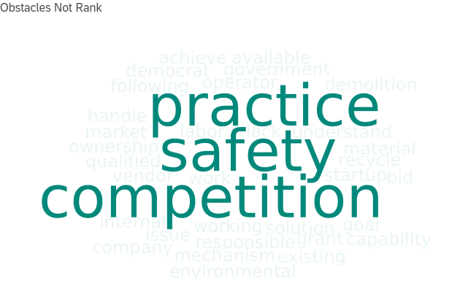
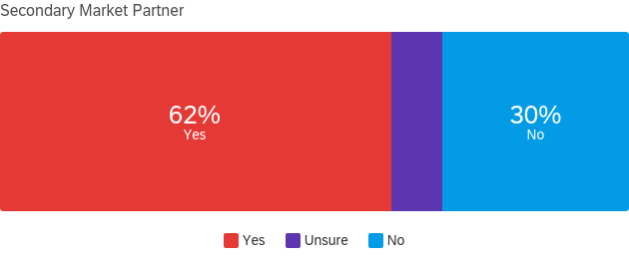
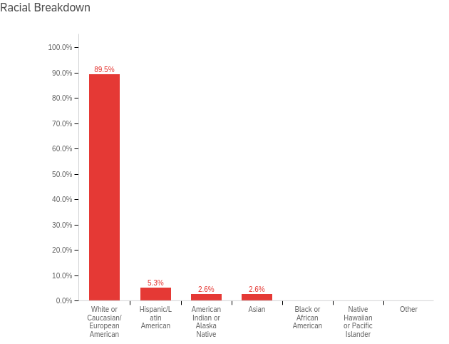
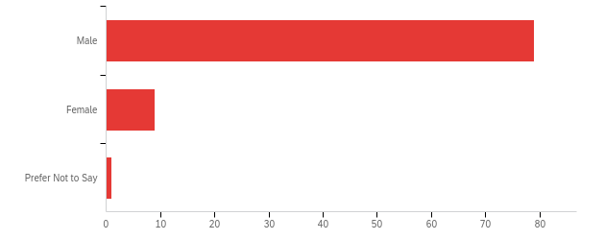
SWOT - Weaknesses
eaknesses
Doubt
Those surveyed wanted to make sure the playing field was fair and uniform across the board. Continuity of policy following the global trends was indicated in the free text fields. Top 3 concerns shown.
Unrealized Potential
Partnerships with a secondary market user, such as a concrete recycling unit or soil amending retailer, were absent in still over 1/3 of those surveyed. Some of this lacking can be conjectured to be because of a lack of those secondary vendors to begin with and those that have a contact, they are limited in their scope as well.
Lack of Diversity
Based on survey results, around 90% of all respondents are white and over 88% are male.
Notes:
Doubt – As part of the survey, I asked what, outside of those in the normal list of survey questions, is heaviest on their minds and the 3 most repeated amongst the 89 was this.
Unrealized – 38% of those surveyed are not taking part in the market at all. Even if that 8% that’s unsure is yes, why is it that 1/3 of businesses are missing out on revenue?
Diversity – 79 male, 9 female, 1 Prefer not. 79 of those surveyed were white, 5 were Hispanic or Latin American, and 2 of each American Indian or Asian. 0% black or others.
© Copyright PresentationGO.com – The free PowerPoint and Google Slides template library

Slide 7
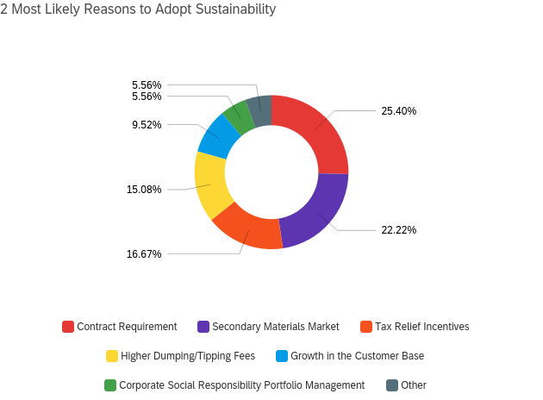
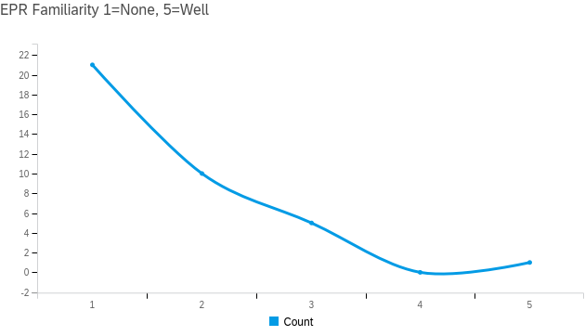
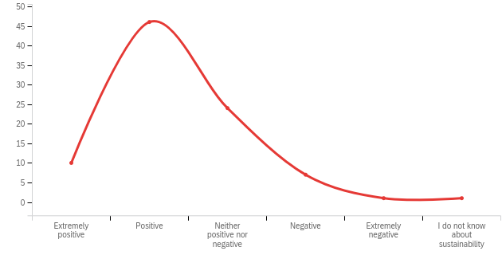
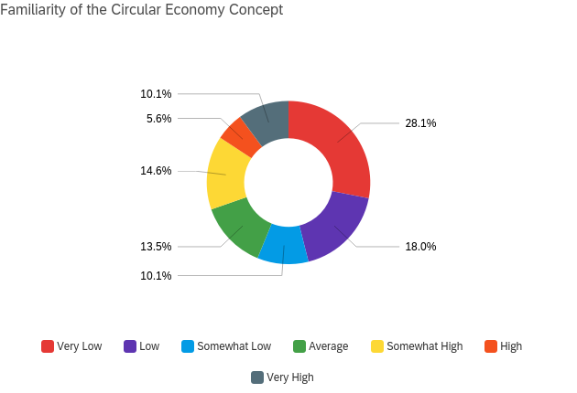
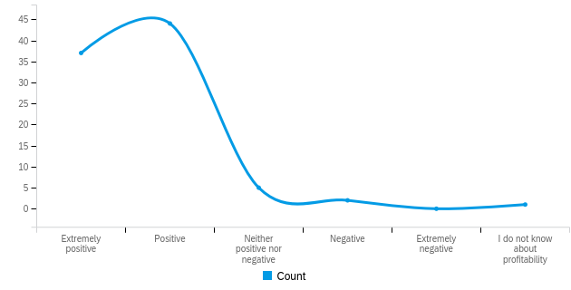
SWOT - Opportunities
pportunities
Growth in Knowledge of the CE
Nearly 54% surveyed know about and are passingly familiar with the CE. The potential here is to find those connections within their sector and implementing.
Willingness to Adopt Sustainability
Out of those surveyed, many were able to identify the actual or perceived hurdles to adoption of sustainable practices in their business models. Creates a focal point for leadership and the association to advocate for with legislative backing and practicing standardization.
Awareness of Trends
Current trends in recycling periodicals are increasingly buzzing about Extended Producer Responsibility. Surveyed respondents are watching the trend and can find ways to implement it into their own operations.
Sustainability
Profitability
Notes:
CE Growth Potential
Reasons to adopt
Trends
© Copyright PresentationGO.com – The free PowerPoint and Google Slides template library

Slide 8
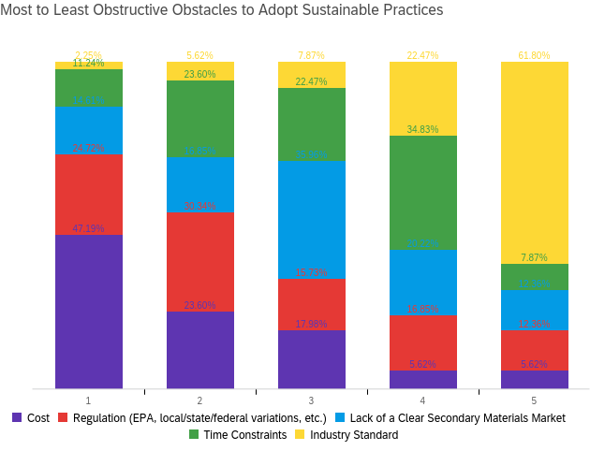
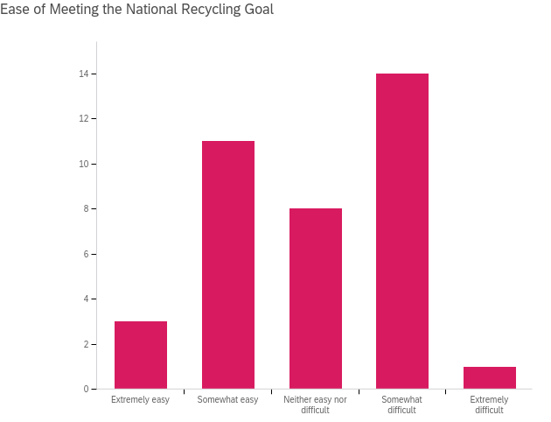
SWOT - Threats
hreats
Hurdles Identified
Majority of respondents were able to quickly identify obstacles to adopting the principles. Inversely, identified items easiest to address for building a common language and consensus within and surrounding the industry.
Institutional Inertia
While only 2% rated the ability of meeting the EPA’s new National Recycling Goal of 50 by 30 as “Extremely Difficult”, a following 38% recognized difficulties in implementation as only “Somewhat Difficult”.
Application
The principles of the CE and their intersectionality to the C&D waste stream are challenging to replicate without local exemplars in the field.
Notes:
© Copyright PresentationGO.com – The free PowerPoint and Google Slides template library

Slide 9



Resources for the Committee, NDA, and Member Organizations
EPA
  National Recycling Strategy
  EPA's 50 by 30
  Facts & Figures about Materials Waste and Recycling/C&D, and Debris Material
Extended Producer Responsibility
International Council for Local Environmental Initiatives (ICLEI)
  ICLEI - USA
Circularity Gap Report 2021
C40 (Austin, Boston, Chicago, Houston, Los Angeles, Miami, Montréal, New Orleans, New York, Philadelphia, Phoenix, Portland, San Francisco, Seattle, Toronto, Vancouver, Washington, DC)
Resilient Organisations
Sendai Framework
Cradle to Cradle Certified®
Ellen MacArthur Foundation
  What is the Circular Economy?
  Circulytics - Measuring Circularity
Notes:
C40 - a network of the world’s megacities committed to addressing climate change. C40 supports cities to collaborate effectively, share knowledge and drive meaningful, measurable and sustainable action on climate change. Started at 40, now around 97.
Sendai – 7 Global Targets by 2030
The Sendai Framework focuses on the adoption of measures which address the three dimensions of disaster risk (exposure to hazards, vulnerability and capacity, and hazard’s characteristics) in order to prevent the creation of new risk, reduce existing risk and increase resilience.

Slide 10


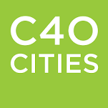



Toy Andrews
Lieutenant Commander | United States Navy
PhD Candidate | Purdue Polytechnic Institute
2018 ESE Interdisciplinary Graduate Program Cohort
Purdue Military Research Institute Fellow
850.501.5350 | andrew93@purdue.edu

